Slide 1
Development of New Capabilities and Enhancements to the USACE Two-Dimensional Reservoir Water Quality Model (CE-QUAL-W2)
PDT Lead: Todd Steissberg (ERDC)
Product Development Team:
Zhonglong Zhang (PSU)
Scott Wells (PSU)
John Kucharski (ERDC)
Billy Johnson (ERDC)
Barry Bunch (ERDC)
Jodi Ryder (ERDC)
Corps District Collaboration:
Brian Zettle (Mobile District, CoP Lead)
Kathryn Tackley (Portland District)
Dan Turner (Northwest Division)
Alexis Mills (Northwest Division)
Laurel Hamilton (Omaha District)
Jim Noren (St. Paul District)

Slide 2
Project Purpose - Recap
This work unit was developed in response to SON ENV 1174, Development of New Capabilities and Enhancements to the USACE Two-Dimensional Reservoir Water Quality Model (CE-QUAL-W2), presented to the 2018 ERARG to address SON ENV 1550, Two-Dimensional Water Quality Capabilities for Reservoir Operations Decision-Making, presented to the 2020 ERARG.
Objectives:
Upgrade CE-QUAL-W2 to incorporate the latest water quality modeling R&D at ERDC
Restructure current CE-QUAL-W2 model source code to use robust data storage file formats that adhere to widely-supported modern standards, such as HDF5 and CSV, enabling seamless linkage with other models, e.g., HEC-RAS and HEC-ResSim, improving multi-model system reliability and reducing maintenance cost of software, models, and linked modeling systems.
Notes:
Keep it simple and clear. You may use a second slide if needed, however.

Slide 3
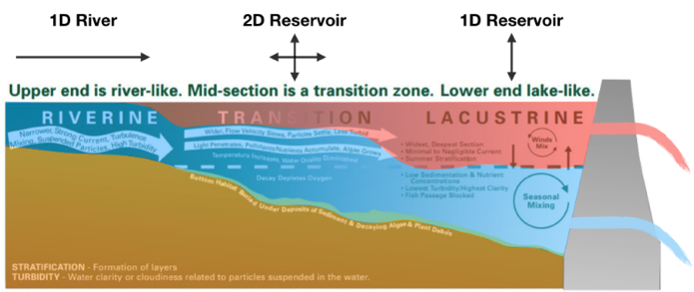
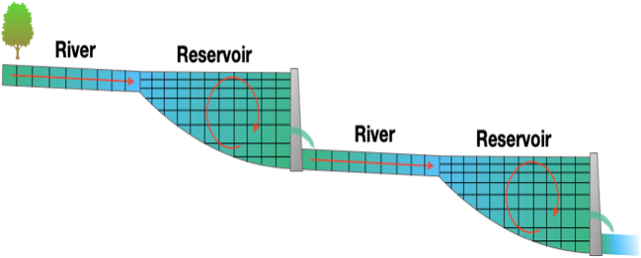
Project Purpose - Recap
Objectives, continued:
Decouple the WQ component from hydrodynamics in the current version of CE-QUAL-W2, allowing water quality simulations to run multiple times with the same hydrodynamic results, eliminating costly repeated hydrodynamic computations
Update the technical reference manual and user manual
Release comprehensive version of CE-QUAL-W2, reviewed by ERDC experts
Notes:
Keep it simple and clear. You may use a second slide if needed, however.

Slide 4
Benefits
The updated CE-QUAL-W2 model will support the Corps’ high priority need for environmental assessment, restoration, and management.
Incorporation of reservoir operations capabilities will enable water quality and other environmental objectives to influence reservoir release decisions, improving model accuracy and delivering high quality multi-objective decision-making to achieve ecosystem benefits.
Critical downstream habitat will be better managed for water quantity (volume, velocity, depths, etc.) in addition to water quality (water temperature, dissolved oxygen, total dissolved gas, etc.).
Linkage of WQ with multi-objective decision analysis increases project benefits while decreasing modeling and project costs.
Development of improved and accessible reservoir water quality modeling capabilities will reduce time and cost associated with upgrading water quality models and adding new model capabilities.
The new file formats improve model robustness and facilitate linking W2 models with other models.
Notes:
Keep it simple and clear. You may use a second slide if needed, however.

Slide 5
Approach
Task 1: Upgrade Water Quality Kinetics
Incorporate new capabilities developed at ERDC-EL into the current CE-QUAL-W2 model maintained by PSU
Develop and integrate a full carbon cycle with nitrogen and phosphorous cycles and integrate into the updated version
Reformulate simulations of BOD groups (CBOD, NBOD, and PBOD) included in current version of W2 to ensure appropriate simulation of these constituents
Upgrade the sediment diagenesis module and merge into the updated version for further testing and validation
Add additional water quality state variables (CH4, H2S, SO4, Fe and Mn Species) into updated version
Notes:
Keep it simple and clear. Particularly with modeling efforts - the interaction of different models, modules and updates needs to be clear. Where in the grand scheme of things does this research fit?

Slide 6
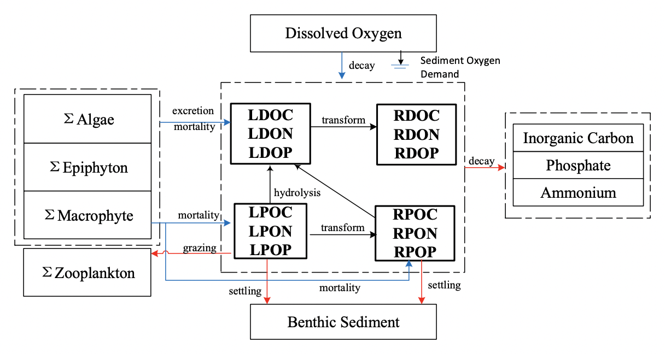
Approach
Task 1 Figure

Slide 7
Approach
Task 2: Upgrade W2 Model Input and Output
Restructure code in order to change storage formats, thereby enabling seamless linkage with other models
Transition to a modern format, such as HDF5 and CSV, to create a reliable, robust storage system that can be easily validated
Leverage existing software to allow harvesting into data catalog systems designed to service a broad range of users, enabling non-expert users to visualize model outputs, map model results, and compare with field data and with other models
Consolidate input datasets into a single file system, allowing users to easily examine input parameters and boundary conditions
Develop a utility to import previous W2 model inputs into the new data storage formats for the updated version
Notes:
Keep it simple and clear. Particularly with modeling efforts - the interaction of different models, modules and updates needs to be clear. Where in the grand scheme of things does this research fit?

Slide 8
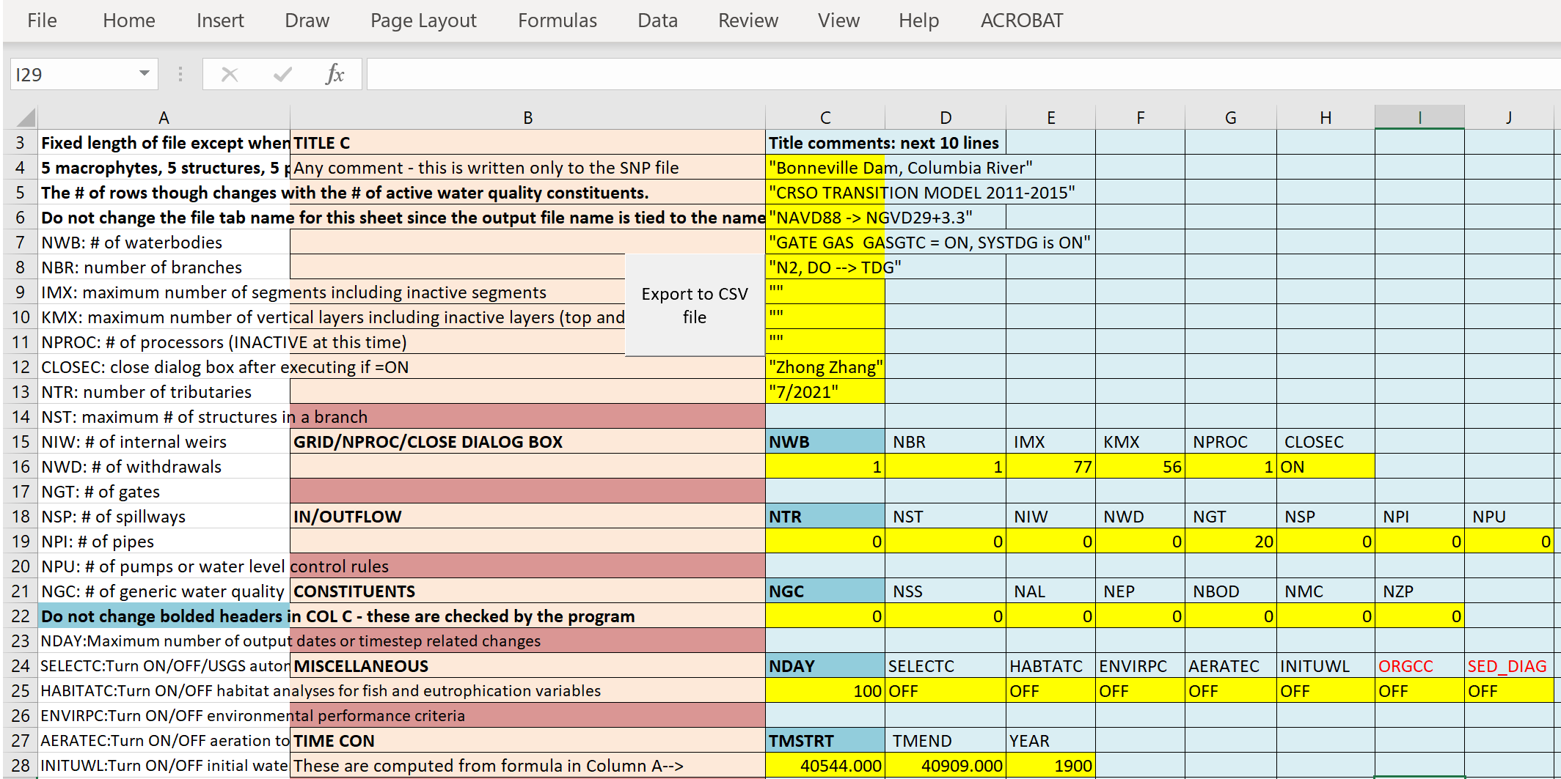
Approach
Task 2: Upgrade W2 Model Input and Output
Excel utility to support develop input control files
Notes:
Keep it simple and clear. Particularly with modeling efforts - the interaction of different models, modules and updates needs to be clear. Where in the grand scheme of things does this research fit?

Slide 9
Approach
Task 3: Create Python/Jupyter Model Framework
Develop a framework, using Python, to link CE-QUAL-W2 with modern scientific Python libraries, enabling development of new input/output and plotting analysis capabilities
Develop plotting capabilities to visualize project bathymetry files, water quality and hydrodynamic time series, and 2D contour plots of reservoir water quality profiles
Develop a prototype Jupyter notebook to link the capabilities together, to create a powerful and flexible self-documented user interface (UI) that is relatively simple to develop
Update and extend this new interface throughout completion of subsequent tasks
Notes:
Keep it simple and clear. Particularly with modeling efforts - the interaction of different models, modules and updates needs to be clear. Where in the grand scheme of things does this research fit?

Slide 10
Approach
Task 4: Develop Reservoir Operations Capabilities
Enable W2 to incorporate water quality and other environmental objectives into reservoir releases calculations, while balancing these with flood control, hydropower, navigation, water supply, and navigation objectives
Incorporate capability into W2 to examine dam flow control impacts on downstream water quality and determine how downstream temperature and water quality objectives will be met
Create capabilities in W2 to examine impacts of dams and flow regulation on downstream temperature and water quality conditions while identifying how operations may be improved to maximize ecosystem benefits
Notes:
Keep it simple and clear. Particularly with modeling efforts - the interaction of different models, modules and updates needs to be clear. Where in the grand scheme of things does this research fit?

Slide 11
Approach
Task 5: Upgrade Hydrodynamic & Water Quality Computation Engine
Decouple water quality component from hydrodynamics in W2 in cases where the water quality state variable does not impact hydrodynamics, thereby increasing computational efficiency
Run hydrodynamic simulations for a prescribed period, store output, and use data as input for multiple water quality simulations
Implement a simultaneous equation solution of the water surface in all branches for the updated model, enhancing hydrodynamic stability of riverine segments
Support increasing demand to include water quality operating objectives for water management by updating selective withdrawal algorithm to account for overlapping withdrawal zones for multiple outlets (versus simply adding them together)
Evaluate using multi-core processing capability with numerical precision of simulations vs. fast code execution
Notes:
Keep it simple and clear. Particularly with modeling efforts - the interaction of different models, modules and updates needs to be clear. Where in the grand scheme of things does this research fit?

Slide 12
Approach
Task 6- CE-QUAL-W2 v5.0 final version with documentation
Prepare and post final release version of CE-QUAL-W2 Version 5.0 to the ERDC website for release
Conduct a case study demonstrating all capabilities included in the final release version of CE-QUAL-W2 and document in a technical note
Post updated CE-QUAL-W2 Technical Reference Manual and User’s Manual to ERDC’s web site
Prepare a final webinar using the case study and present to USACE District and Division staff, including water quality modelers and managers
Notes:
Keep it simple and clear. Particularly with modeling efforts - the interaction of different models, modules and updates needs to be clear. Where in the grand scheme of things does this research fit?

Slide 13
Field Engagement
Project Planning
Team meetings & conference calls
Periodic project updates to PDT, ERARG members, and field personnel by phone, web meeting, and email
Reporting
Provided quarterly updates to the USACE Water Quality Committee
Field Work Coordination
Coordination with NWD (Kathryn Tackley, Dan Turner, Alexis Mills, and Norm Buccola)

Slide 14
Scheduled Products¹
Scheduled Products
Description | Scheduled Due Date | Current Percent Complete | Projected Completion Date
 | (Qtr/Yr) | (%) | (Qtr/Yr)
1. CE-QUAL-W2 Version 4.5 | Q2/FY21 | 100 | Q2/FY21
2. CE-QUAL-W2 Version 5.0 Alpha | Q2/FY22 | 50 | Q2/FY22
3a. Python Framework 3b. Prototype Jupyter Notebook 3c. Plotting Capability | Q1/FY21 Q1/FY21 Q1/FY21 | 100 100 100 | Q1/FY21 Q1/FY21 Q1/FY21
4. CE-QUAL-W2 Operations Capability | Q2/FY22 | 50 | Q4/FY21
¹ As per work unit documentation
Notes:
Include all PRODUCTS/DELIVERABLES as specified in the original WU documentation

Slide 15
Scheduled Products¹
Scheduled Products
Description | Scheduled Due Date | Current Percent Complete | Projected Completion Date
 | (Qtr/Yr) | (%) | (Qtr/Yr)
5. CE-QUAL-W2 Version 5.0 Beta | Q2/FY23 | 0 | Q2/FY23
6a. CE-QUAL-W2 Version 5.0 Final 6b. User Manual 6c. Technical Reference Manual 6d. Webinar 6e. Technical Note | Q4/FY23 Q4/FY23 Q4/FY23 Q4/FY23 Q4/FY23 | 0 75 75 0 0 | Q4/FY23 Q4/FY23 Q4/FY23 Q4/FY23 Q4/FY23
¹ As per work unit documentation
Notes:
Include all PRODUCTS/DELIVERABLES as specified in the original WU documentation

Slide 16
Additional Products/Achievements
Additional Products/Achievements
Description | (Qtr/Yr)
Recruited computer scientist at EL-EPW in FY21 New features presented at National Conference for Ecosystem Restoration (NCER), July 2021 Additional features developed for V4.5, funded by reimbursable projects New features presented at California Water and Environmental Modeling Forum (CWEMF), October 2021 | Q3/FY21 Q4/FY21 Q4/FY21 Q1/FY22

Slide 17
FY21 Accomplishment 1: Extended CE-QUAL-W2 WQ Algorithms (Task 1)
General Constituents
Bacteria
CBOD
DGP, N2
TDG
Algae toxins
H2S, CH4, SO4, Fe(II), FeOOH, Mn(II), MnO2
Organic Carbon
Zero order
First order
Sediment diagenesis
Status: On Time

Slide 18
FY21 Accomplishment 1: Full Organic Carbon Cycle and BOD (Task 1)
Status: On Time

Slide 19

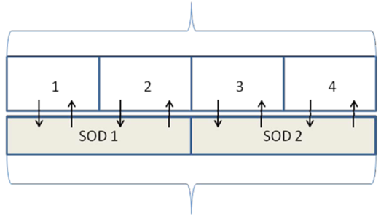
FY21 Accomplishment 1: Sediment Diagenesis Module (Task 1)
Inputs: csv format
Outputs: Bottom layer and averaged outputs
Simplified computations to steady-state
Add SOD and sediment fluxes for all water column layers
Add initial conditions for NO3 in sediment layers (layers 1 and 2)
Add an averaged SOD and sediment fluxes into the output for each segment
Add a subroutine for computing sediment POM and delete the corresponding parts in water-quality.f90
Add sediment POM (POC, PON and POP) computation (Subroutine SedimentPOM)
Add the correction for calculating SD_W12
Add a correction for PO4 partitioning coefficient in layer 1
Add partitioning of sediment NH4
Modify the numerical solution for CH4
Area
Surface cell
Water Column
Bottom cell
Active Sediment Layer
Deep Sediments
Status: On Time

Slide 20
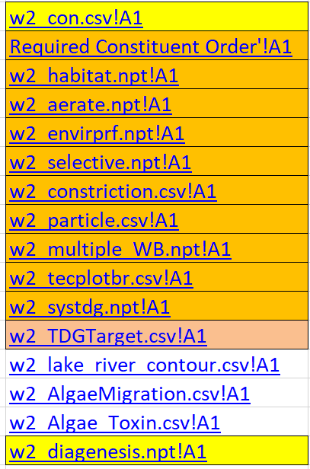
FY21 Accomplishment 2: Upgraded Model Input and Output (Task 2)
Excel file w2_con.xlsm → w2_con.csv
Added capability to use Excel to create the model control files
Simplified editing of input files
No graph.npt file required
Easier cutting and pasting
Simplified I/O
Files more organized
Variable names and explanations at user’s fingertips
Formulae included in released Excel tool assist in control file development
Status: On Time

Slide 21
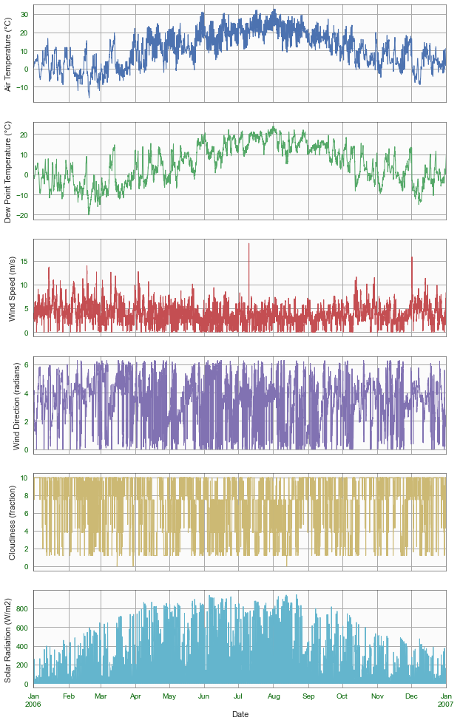
FY 21 Accomplishment 3: Visualization Capabilities (Task 3)
Description: Visualization capabilities were developed for CE-QUAL-W2 using Python.
Plotting functions were developed for the meteorology and water quality input and output data.
Julian Days are converted to date-time format allowing the date axis to scale from minutes to decades with readable tick intervals and labels.
Default plot options were set to make clear and readable plots.
Status: On time
Notes:
Describe product and capability, importance/impact, etc.. Employ images generously. Tell a good story.

Slide 22
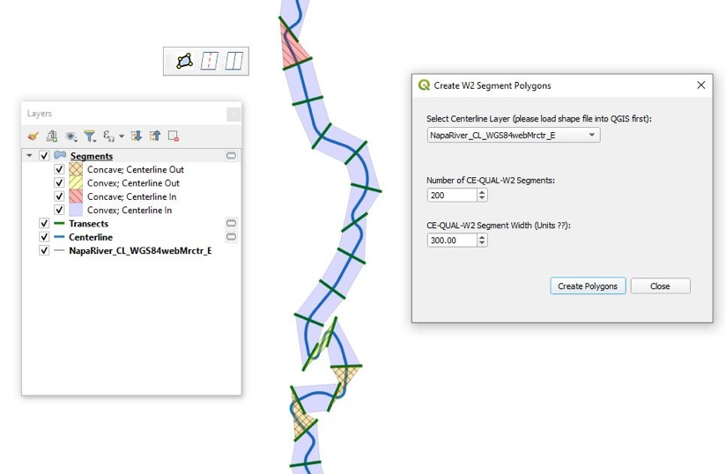
FY 21 Accomplishment 3: CE-QUAL-W2 Geometry QGIS Plug-in (Task 3)
Description: The CE-QUAL-W2 Geometry Preprocessor QGIS Plug-in allows fast and easy creation of model bathymetry files, given a digital elevation model (DEM) and a polyline shapefile of the centerline of the waterbody.
After loading the DEM and shapefile of the centerline, the tool generates the cross-sections.
The user can then split and/or merge cross-sections to refine the model bathymetry.
Then the model bathymetry can be exported for the CE-QUAL-W2 model.
Status: On time
Notes:
Describe product and capability, importance/impact, etc.. Employ images generously. Tell a good story.

Slide 23
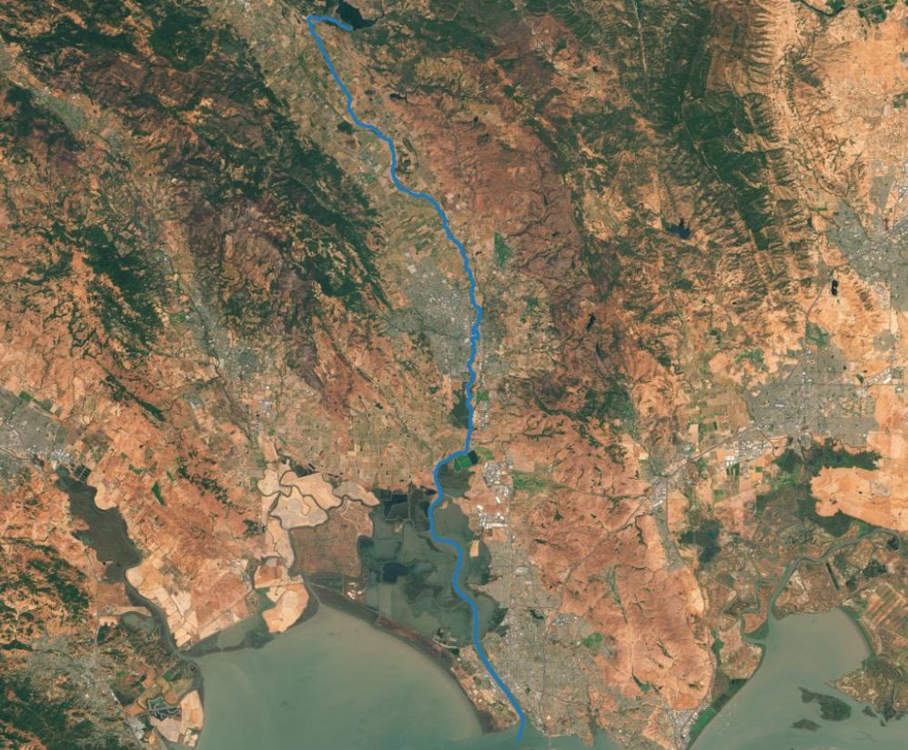
FY 21 Accomplishment 3: CE-QUAL-W2 Geometry QGIS Plug-in (Task 3)
Notes:
Describe product and capability, importance/impact, etc.. Employ images generously. Tell a good story.

Slide 24
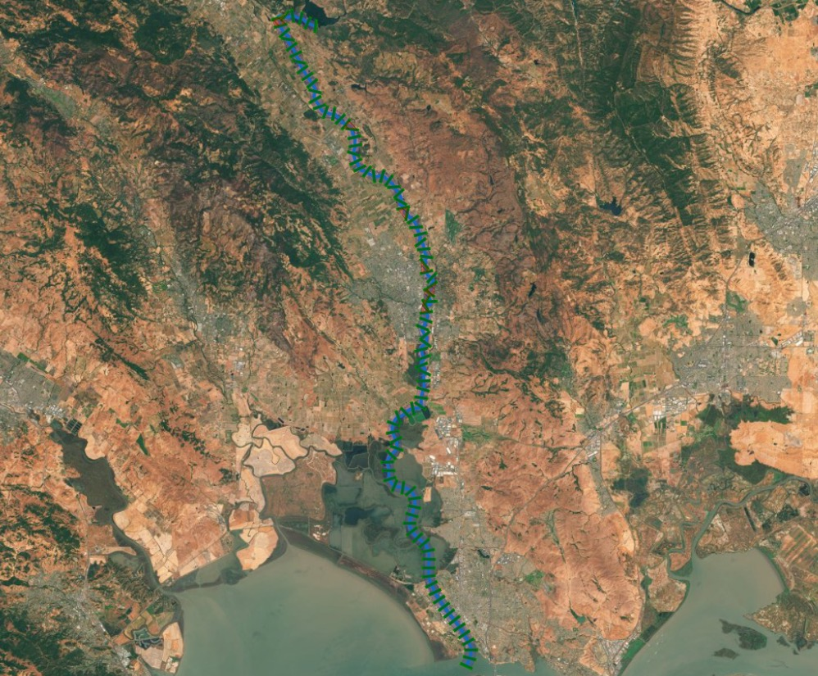
FY 21 Accomplishment 3: CE-QUAL-W2 Geometry QGIS Plug-in (Task 3)
Notes:
Describe product and capability, importance/impact, etc.. Employ images generously. Tell a good story.

Slide 25
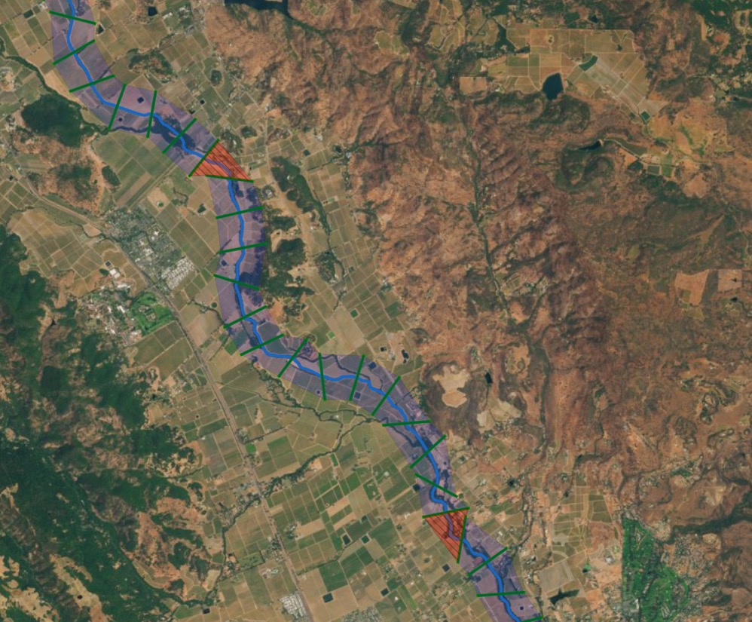
FY 21 Accomplishment 3: CE-QUAL-W2 Geometry QGIS Plug-in (Task 3)
Notes:
Describe product and capability, importance/impact, etc.. Employ images generously. Tell a good story.

Slide 26
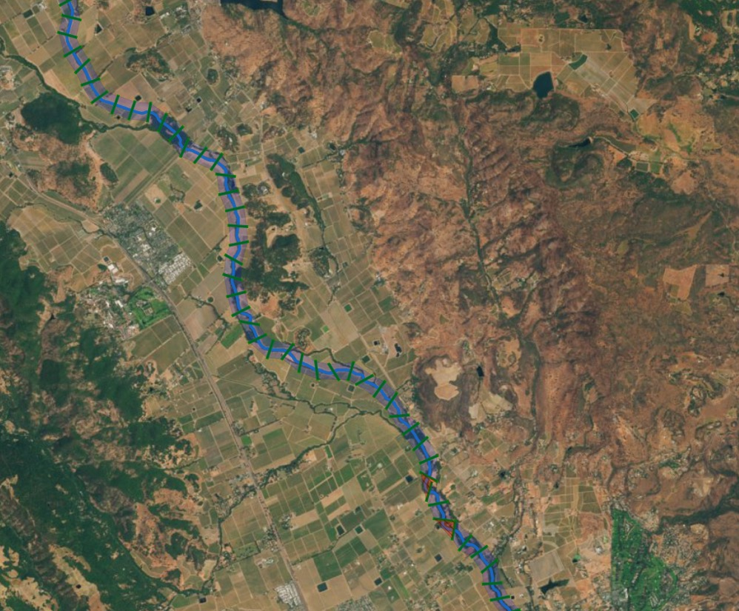
FY 21 Accomplishment 3: CE-QUAL-W2 Geometry QGIS Plug-in (Task 3)
Notes:
Describe product and capability, importance/impact, etc.. Employ images generously. Tell a good story.

Slide 27

FY 21 Accomplishment 3: CE-QUAL-W2 Geometry QGIS Plug-in (Task 3)
Split
Split
Merge
Split
Merge
Merge, then Split
Notes:
Describe product and capability, importance/impact, etc.. Employ images generously. Tell a good story.

Slide 28
FY 21 Accomplishment 4: WQ Operations Capability (Task 4)
Panel (a) and (b) are examples of optimal operation rules at a Corps dam (Folsom) that minimize flood risk while maximizing water supply given the evaluation of an ensemble of synthetic records.
Panels (c) and (d) are color coded to show how these various rules would have been applied during the historic record (e.g., blue = flood control release, red = hedge by releasing 80% of water supply demand).
The black line shows what the reservoir storage would have been following these optimal rules.
The grey line shows the observed reservoir storage during this period.
Status: On Time
Notes:
Describe product and capability, importance/impact, etc.. Employ images generously. Tell a good story.

Slide 29
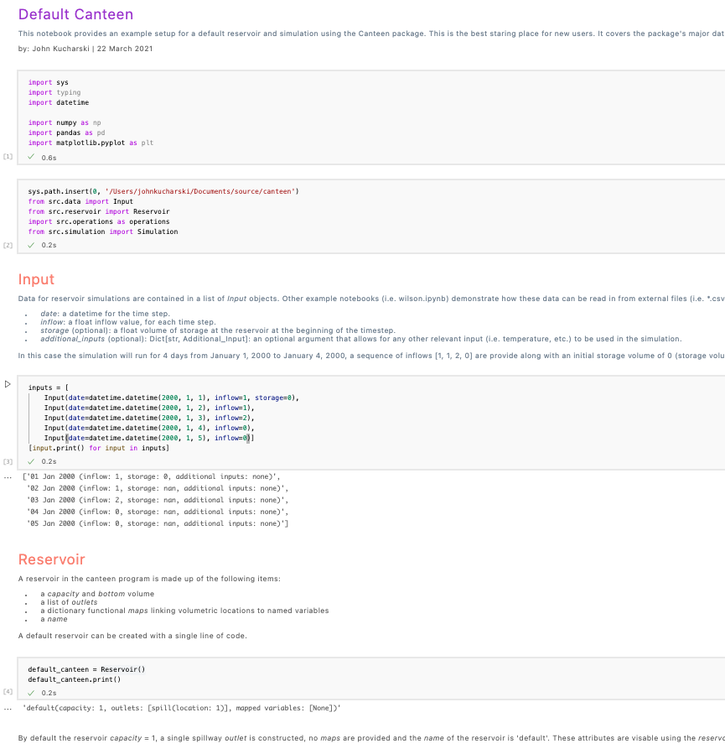
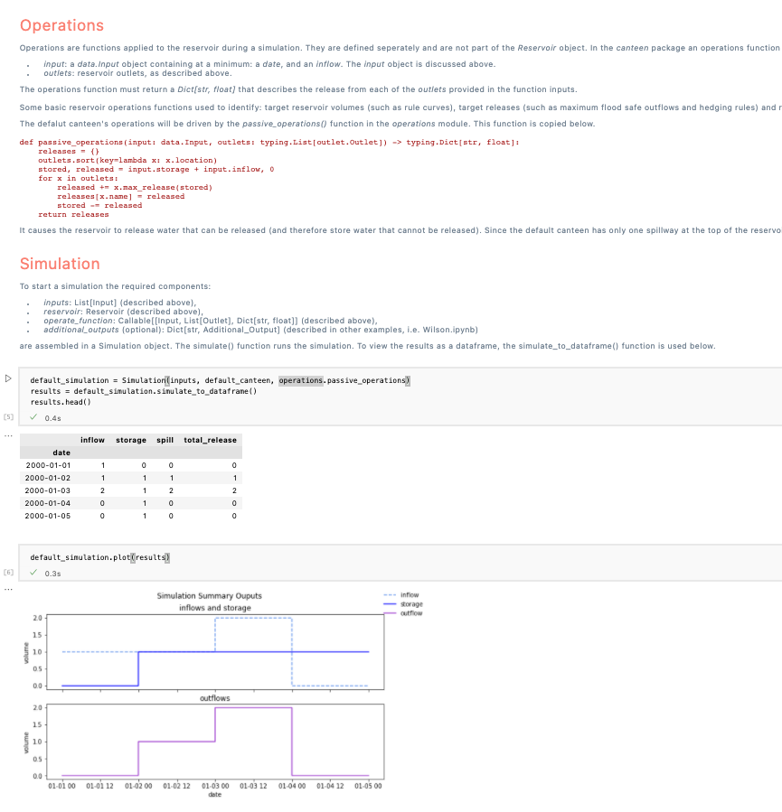
FY 21 Accomplishment 4: WQ Operations Capability (Task 4)
Status: On Time
Notes:
Describe product and capability, importance/impact, etc.. Employ images generously. Tell a good story.

Slide 30
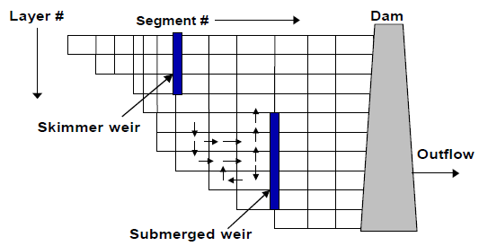
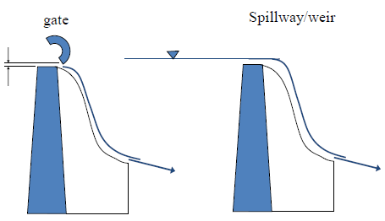
FY21 Accomplishment 5: Hydrodynamic Engine Updates (Task 5)
Added minimum water level (MINWL) above powerhouse as a criterion for moving to a different selective withdrawal structure
Added capability to set dynamic port elevation as active when a port selection rule is not active
Status: On Time

Slide 31
FY 21 Accomplishment 6: CE-QUAL-W2 Version 4.5 Official Release
Description: CE-QUAL-W2 Version 4.5 has been completed and released. The executables, source code, user’s manual, and other documentation have been posted to ERDC’s GitHub and PSU’s website.
Updated algorithms
Updated and extensively edited user’s manual, five parts, 1,094 pages. Authors: Dr. Scott Wells and Dr. Zhonglong Zhang, Portland State University
https://github.com/EnvironmentalSystems/CE-QUAL-W2
http://www.ce.pdx.edu/w2/
Status: On time
Notes:
Describe product and capability, importance/impact, etc.. Employ images generously. Tell a good story.

Slide 32
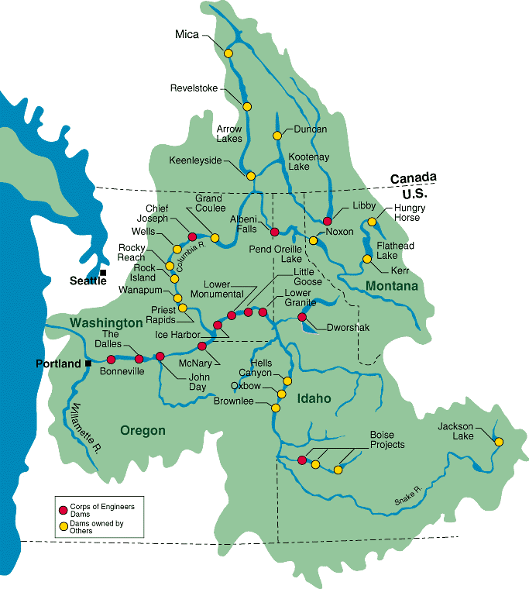
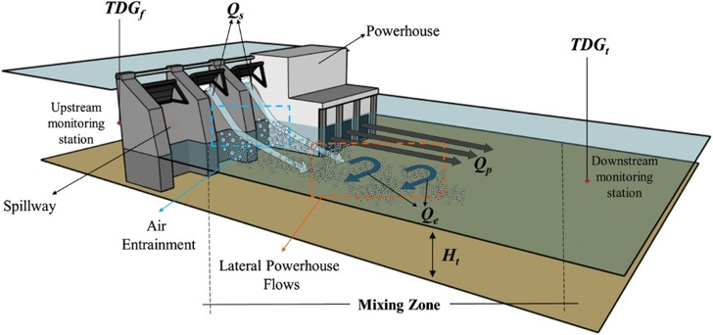
Additional Features in Version 4.5 Total Dissolved Gas (TDG) (Funded by Portland District)
Status: On Time
Estimates the forebay and tailwater TDG pressures resulting from reservoir operations.
TDG Computed from “N2+DO” and DGP

Slide 33
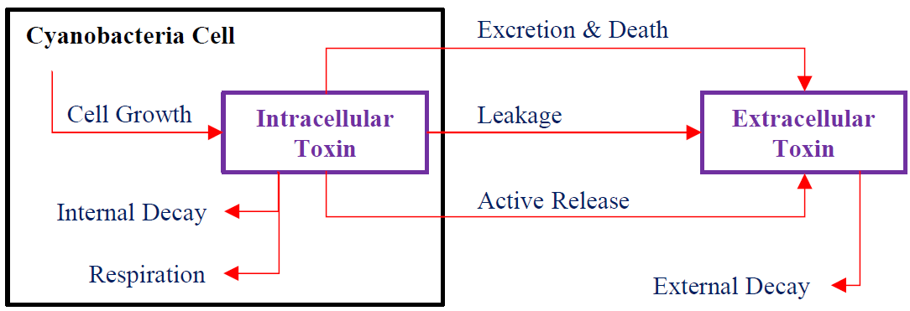
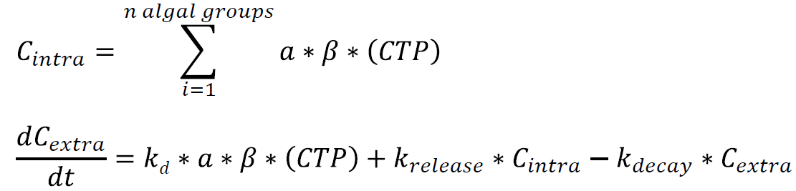
Additional Features in Version 4.5 Algae Toxins (Funded Oregon Clean Water Services)
CTP = fraction of algal group producing toxin
β = ratio of intra. toxin mass to mass of dry weight OM

Slide 34

Additional Features in Version 4.5 Algae Vertical Migration (Funded by other organizations)
1D water column
No water velocity
Plankton velocity - time-varying velocity:
$v\left(t\right)=2\left(\frac{2π}{86,400 s}\right)cos\left(\frac{2π}{86,400 s}t+\frac{π}{2}\right)$
Source: NASA, https://climate.nasa.gov/blog/2788

Slide 35
Additional Features in Version 5.0 Mercury (Hg) Cycle Module (Funded by Idaho Power Inc. and others)
Elemental Hg Inorganic Hg Methylmercury
Conceptual Mercury Cycle in a Water Body

Slide 36
Synopsis
Funding
FY20 $250K
FY21 $385K
FY22 $375K
FY23 $290K
Project $1300K
Project status
On schedule
Project focus
On target
Other comments
PSU CESU needs to modified to fund FY22 development
Notes:
Funding for all FY’s funded

Slide 37
Summary
Updated and extended water quality algorithms
Full Carbon cycle and BOD
Sediment diagenesis module
Total Dissolved Gas (TDG)
Algae toxins
Algae vertical migration
Mercury cycle module
Upgraded model input and output
CSV input and output, model control file
Excel utility for input/output
Extended user interface
Plotting capabilities
CE-QUAL-W2 Geometry Preprocessor QGIS Plug-in
Water quality operations capability (to be integrated in V5.0)
Hydrodynamic engine updates (to be completed in V5.0)
Official V4.5 Release Completed

